Slide 1
Cause Of Death
INTERNSHIP BATCH -33

Slide 2
EDA Steps
1.Checking the missing values
2.Checking for numerical columns
3.Checking for the distribution of numerical variables
4.Checking for Categorical variables
5.Types of categorical variables
6.Visualization
7.Checking Skewness
8.Outliers detection
9.correlation on columns in the dataset

Slide 3
1.Checking the missing value
Missing value can be checked by the following python code
missing_value=[feature for feature in df.columns if df[feature].isnull().sum()>1]
missing_value
Observation:- There are no missing values present in the dataset

Slide 4
2. Checking the numerical columns
Numerical values can be checked using the following python code
numerical_feature=[feature for feature in df.columns if df[feature].dtypes!="O"]
df[numerical_feature]
Observation:-There are 1 numerical values present in the dataset

Slide 5
3.Checking the categorical variable
Categorical variable can be checked using the following python code
discrete_feature=[feature for feature in df.columns if feature not in numerical_feature]
df[discrete_feature]
Observation:- There are 2 categorical values present in dataset
Rest of the columns are Continous variables

Slide 6
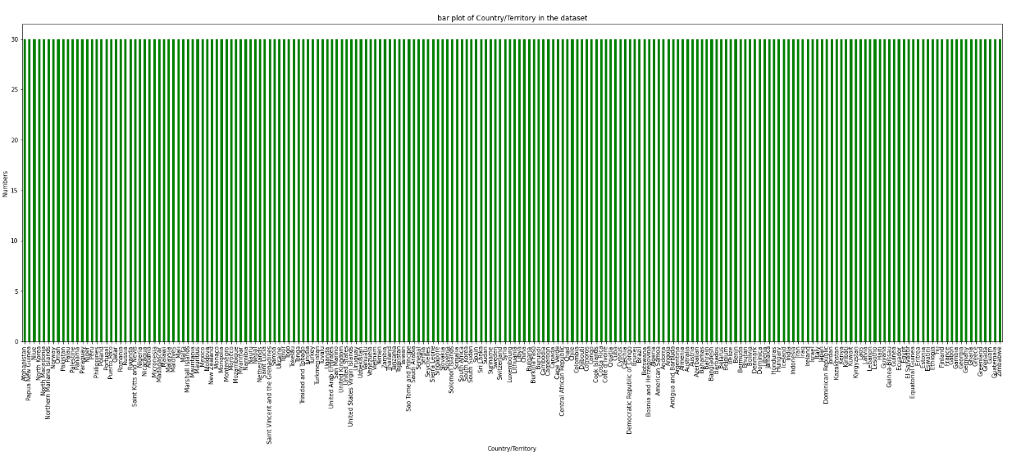
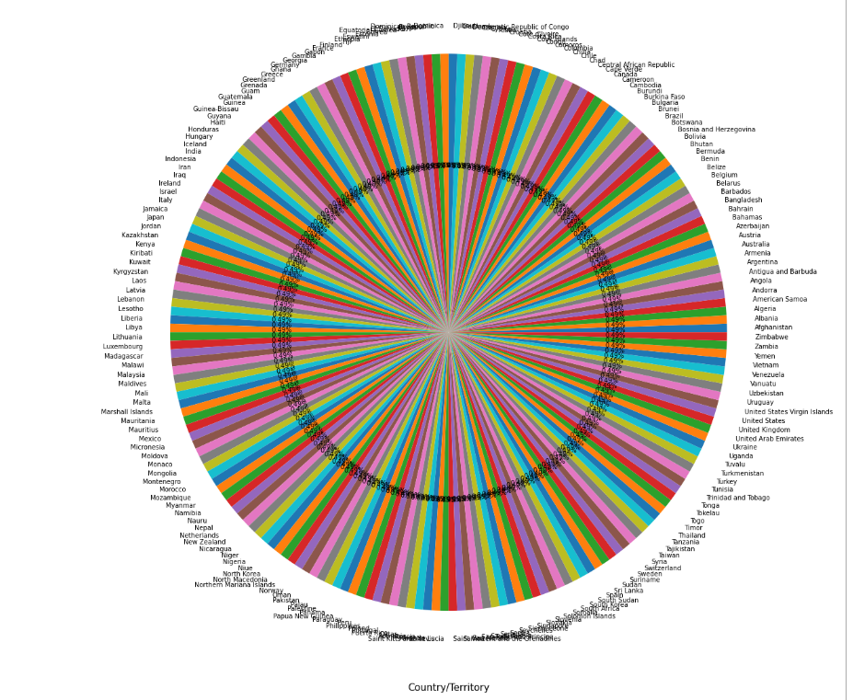
Data visualization
Country/Territory
Country/Territory
observation:-
we can observe 204 unique variables in the dataset and
all the variables are having uniformly distributed and
each variables in the column are having count of 30 .
each of the countries in the dataset is 0.49% of the dataset

Slide 7
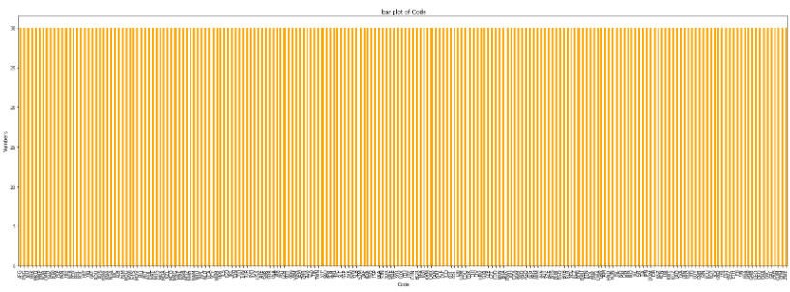
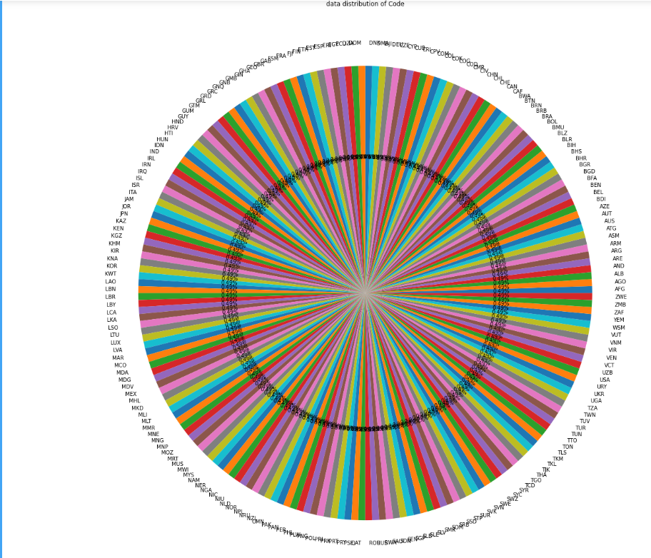
observation:-
we can observe 204 unique variables in the dataset and
all the variables are having uniformly distributed and
each variables in the column are having count of 30 .
each of the code corresponding to countries in the dataset is 0.49% of the dataset

Slide 8
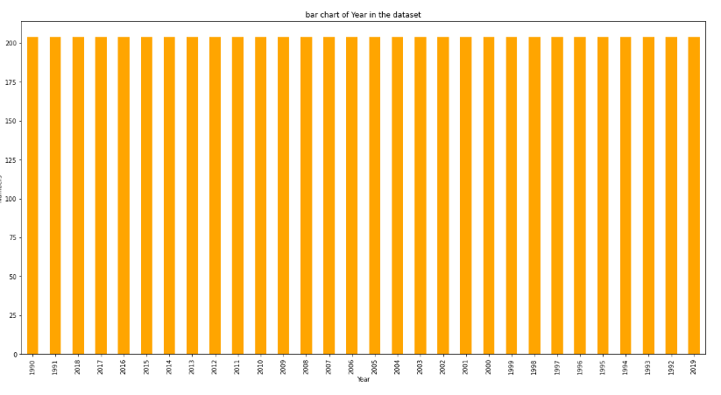
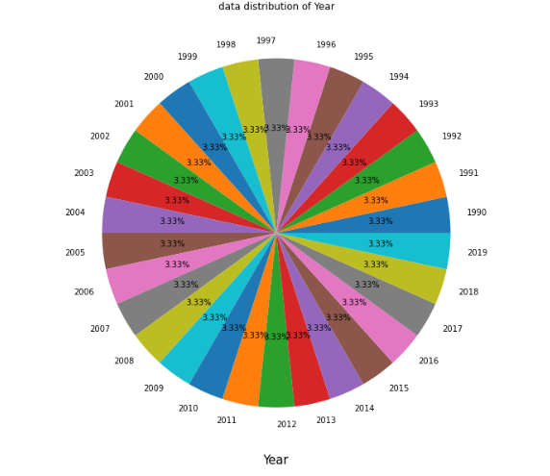
Visual appealing web-page layout
observation:-
We can see that there are 30 unique year in the dataset and
they re uniformly distributed in the data set and their distribution percentage is
3.33% in all the years through out the datsaet.
We can observe 200 observations in each of the year in the datset.
we can see the data is from 1990 to 2019 in the dataset

Slide 9
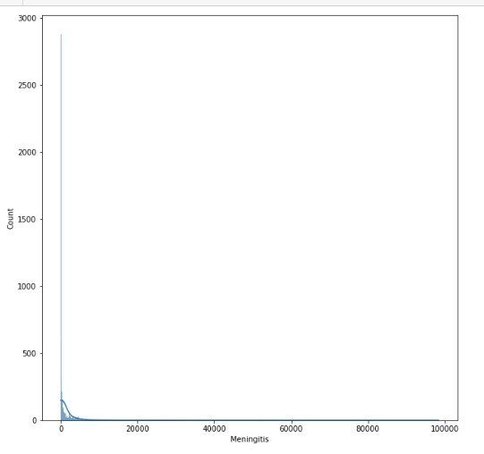
observation:- we can observe 2020 unique values in the Meningitis column and
the min value in this column is zero and the max value in the column is 98358.
and we can observe maxumum observations are taking place in zero in the column

Slide 10
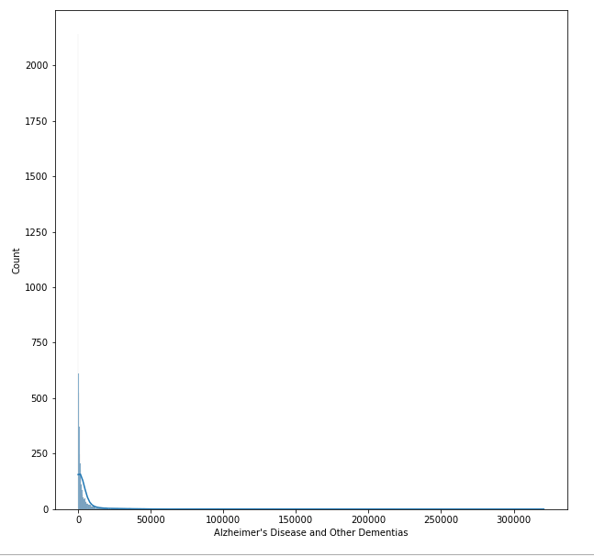
observation:
we can observe 3037 unique values in the 'Alzheimer s Disease and Other Dementias' column and
the min value in this column is zero and the max value in the column is 320715.
and we can observe maxumum observations are taking place in zero in the column

Slide 11
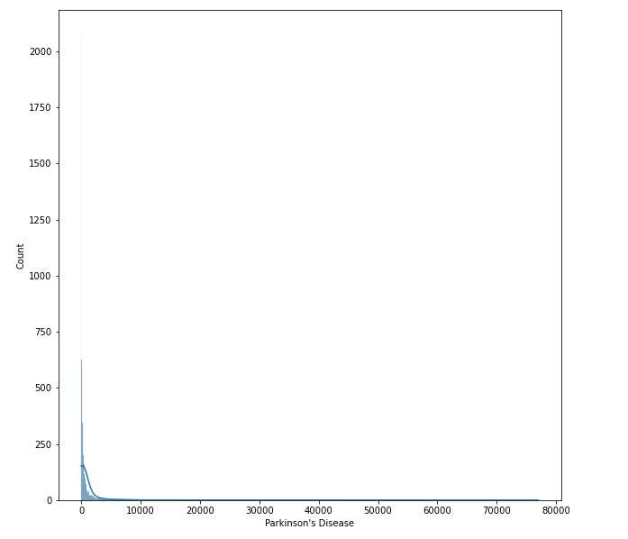
observation:
we can observe 1817 unique values in the Parkinson's Disease column and
the min value in this column is zero and the max value in the column is 76990.
and we can observe maxumum observations are taking place in zero in the column.
we can observe max count observations in the dataset are below 10000

Slide 12
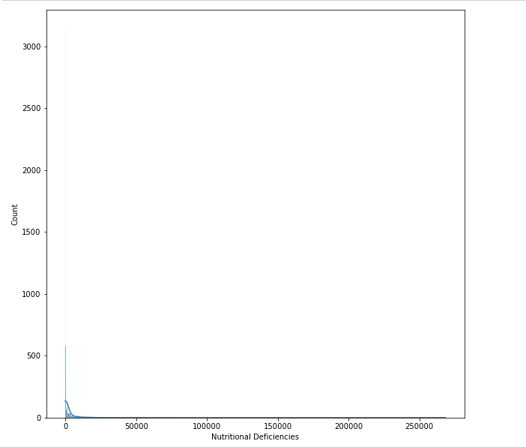
observation:
we can observe 2147 unique values in the Nutritional Deficiencies column and
the min value in this column is zero and the max value in the column is 268223.
and we can observe maxumum death observed are taking place in zero in the column.
we can observe max count observations in the dataset are below 50000

Slide 13
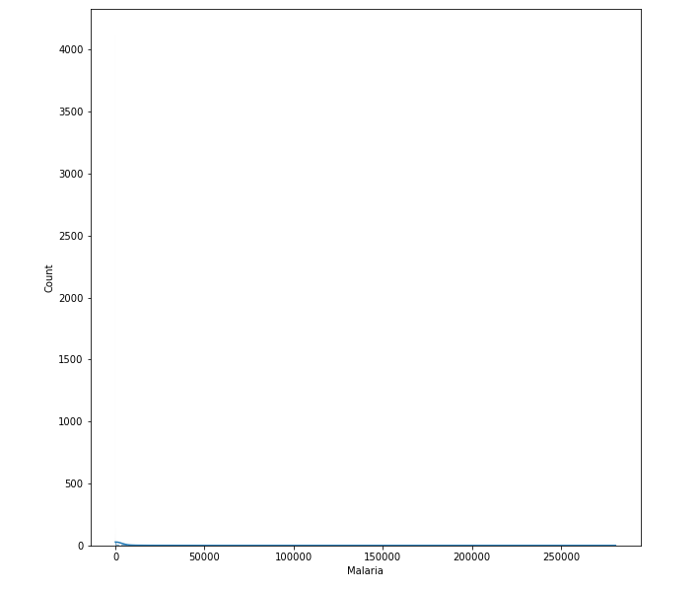
observation:
we can observe 1723 unique values in the Malaria column and
the min value in this column is zero and the max value in the column is 280604.
and we can observe maxumum death observed are taking place in zero in the column.

Slide 14
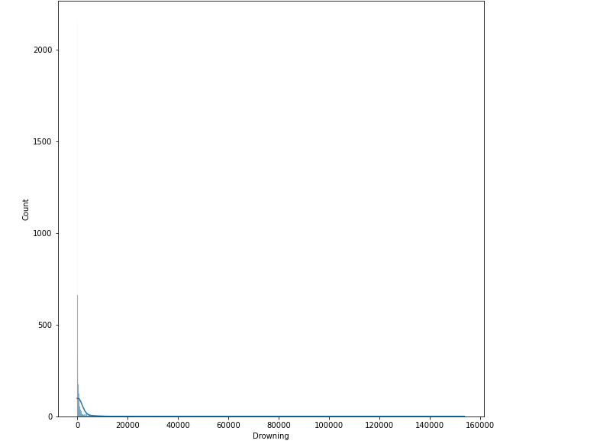
observation:
we can observe 1875 unique values in the Drowning column and
the min value in this column is zero and the max value in the column is 153773.
and we can observe maxumum death observed are taking place in zero in the column.
we can observe max count observations in the dataset are below 20000

Slide 15
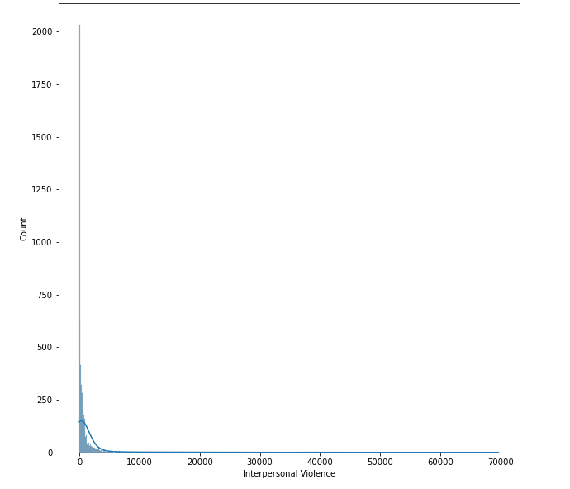
observation:
we can observe 2142 unique values in the Interpersonal Violence column and
the min value in this column is zero and the max value in the column is 69640.
and we can observe maxumum death observed are taking place in zero in the column.
we can observe max count observations in the dataset are below 10000

Slide 16
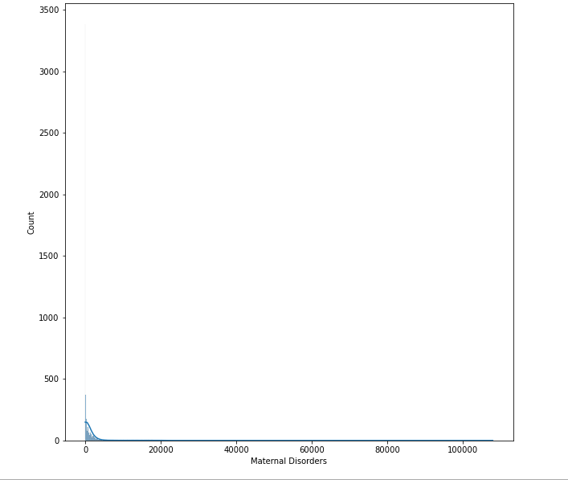
observation:
we can observe 1818 unique values in the Maternal Disorders column and
the min value in this column is zero and the max value in the column is 107929.
and we can observe maxumum death observed are taking place in zero in the column.
we can observe max count observations in the dataset are below 10000

Slide 17
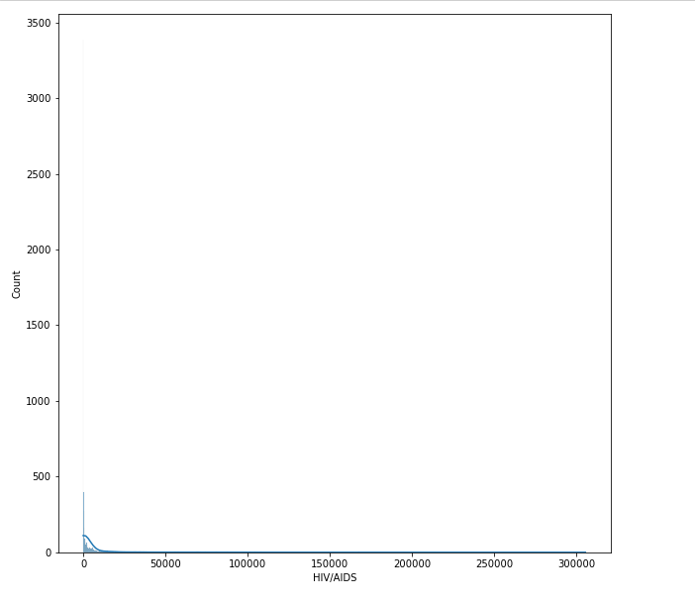
observation:
we can observe 2412 unique values in the HIV/AIDS column and
the min value in this column is zero and the max value in the column is 305491.
and we can observe maxumum death observed are taking place in zero in the column.
we can observe max count observations in the dataset are below 50000

Slide 18
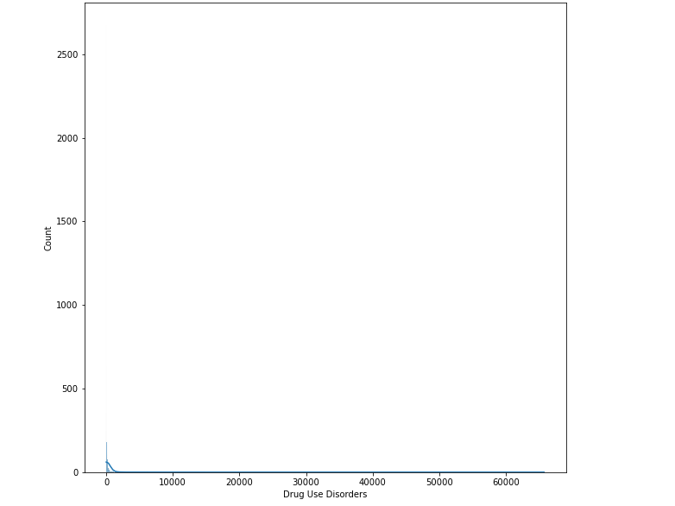
observation:
we can observe 876 unique values in the 'Drug Use Disorders' column and
the min value in this column is zero and the max value in the column is 65717.
and we can observe maxumum death observed are taking place in zero in the column.
we can observe max count observations in the dataset are below 10000

Slide 19
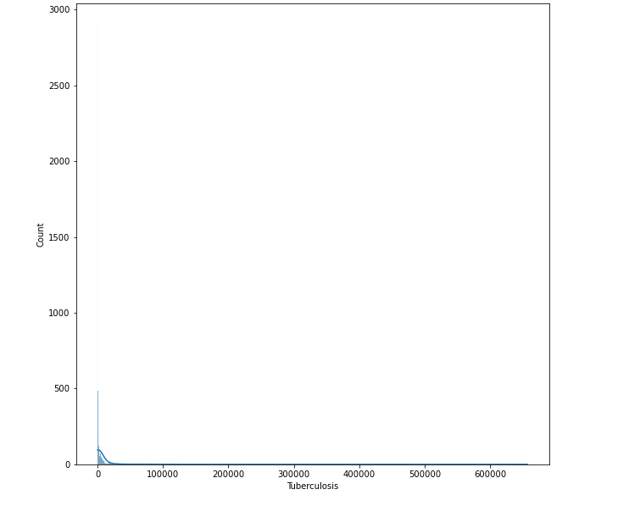
observation:
we can observe 2843 unique values in the 'Tuberculosis' column and
the min value in this column is zero and the max value in the column is 657515.
and we can observe maxumum death observed are taking place in zero in the column.
we can observe max count observations in the dataset are below 10000

Slide 20
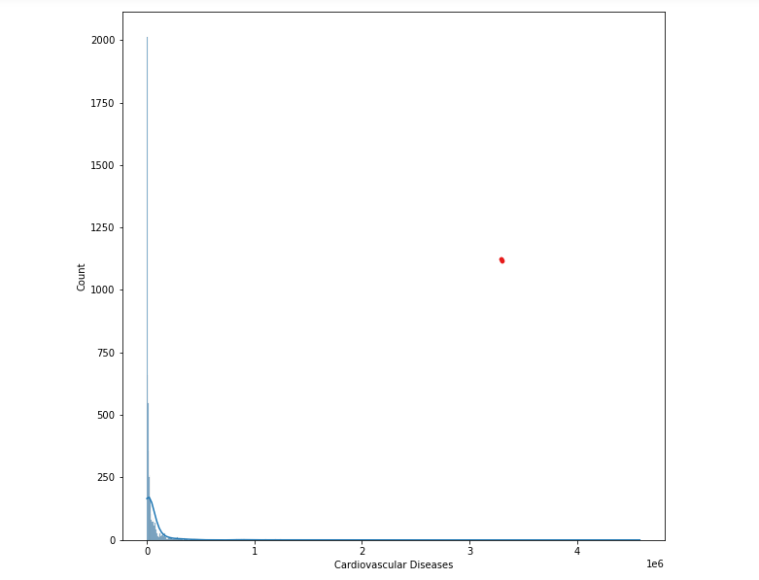
observation:
we can observe 5225 unique values in the 'Cardiovascular Diseases' column and
the min value in this column is zero and the max value in the column is 4584273.
and we can observe maxumum death observed are taking place in zero in the column.
we can observe max count observations in the dataset are below 1e6

Slide 21
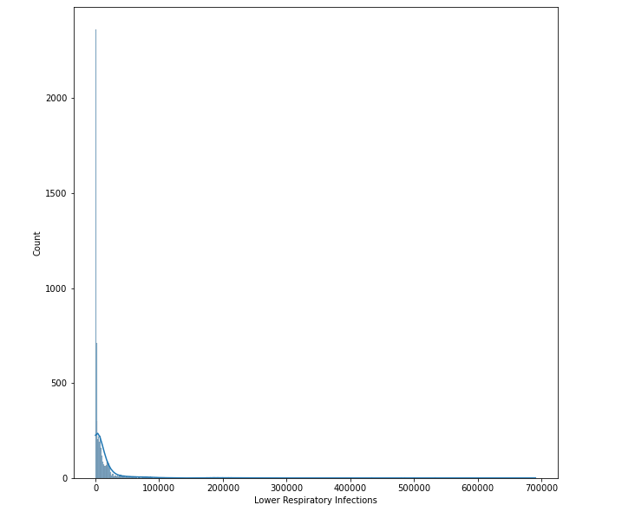
observation:
we can observe 4106 unique values in the 'Lower Respiratory Infections' column and
the min value in this column is zero and the max value in the column is 690913.
and we can observe maxumum death observed are taking place in zero in the column.
we can observe max count observations in the dataset are below 10000

Slide 22
observation:
we can observe 1817 unique values in the Parkinson's Disease column and
the min value in this column is zero and the max value in the column is 76990.
and we can observe maxumum observations are taking place in zero in the column.
we can observe max count observations in the dataset are below 10000

Slide 23
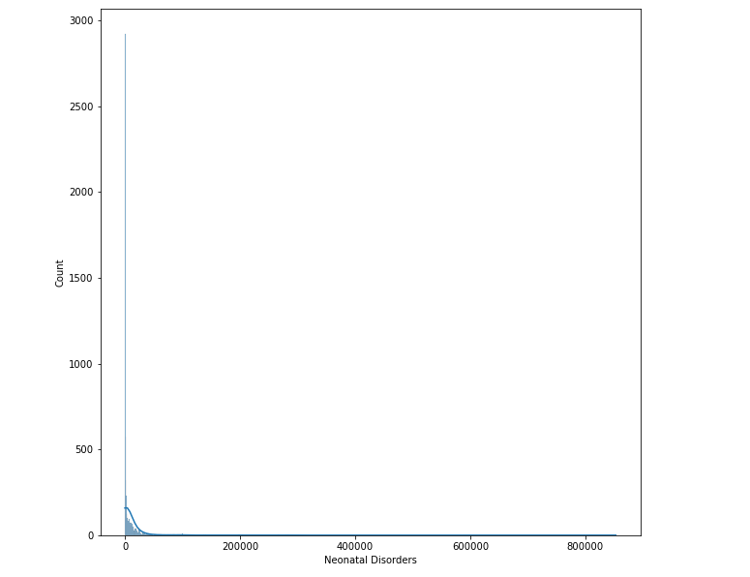
observation:
we can observe 3553 unique values in the 'Neonatal Disorders' column and
the min value in this column is zero and the max value in the column is 852761.
and we can observe maxumum death observed are taking place in zero in the column.
we can observe max count observations in the dataset are below 20000

Slide 24
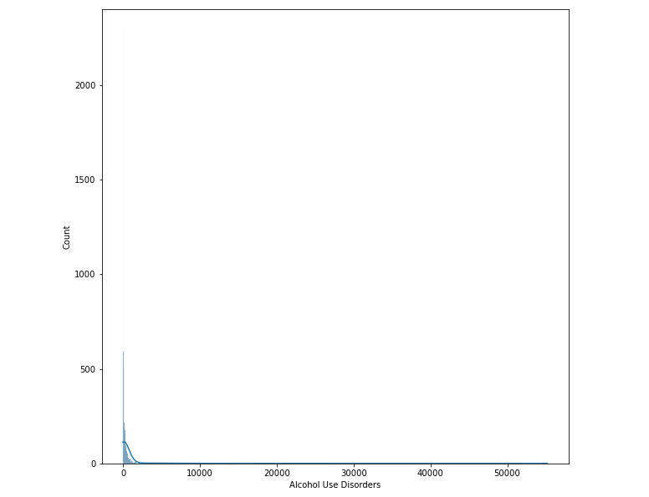
observation:
we can observe 1287 unique values in the 'Alcohol Use Disorders' column and
the min value in this column is zero and the max value in the column is 55200.
and we can observe maxumum death observed are taking place in zero in the column.
we can observe max count observations in the dataset are below 10000

Slide 25
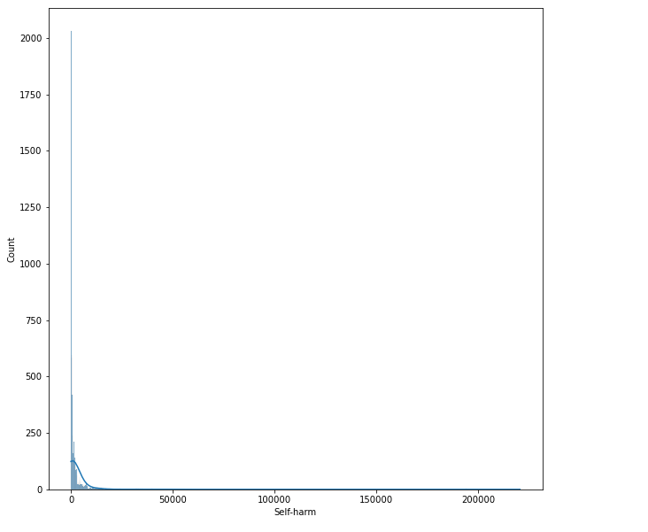
observation:
we can observe 2758 unique values in the 'Self-harm' column and
the min value in this column is zero and the max value in the column is 220357.
and we can observe maxumum death observed are taking place in zero in the column.
we can observe max count observations in the dataset are below 50000

Slide 26
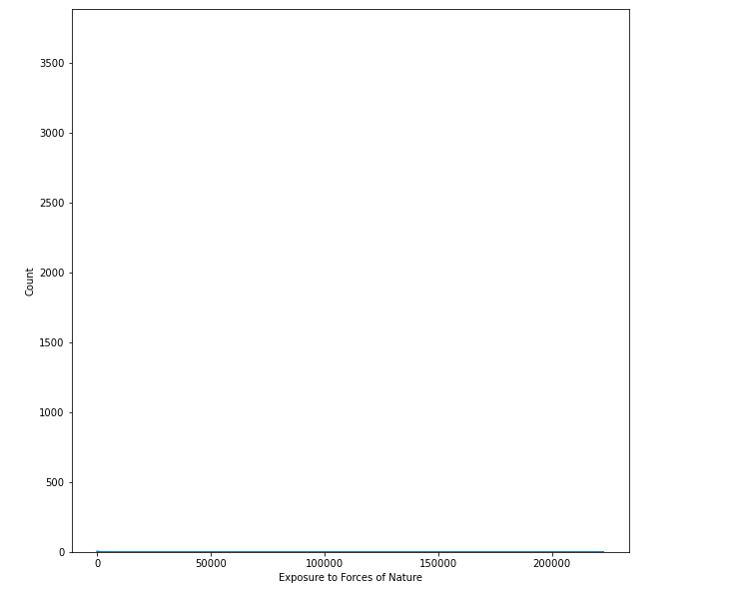
observation:
we can observe 478 unique values in the 'Exposure to Forces of Nature' column and
the min value in this column is zero and the max value in the column is 222641.
and we can observe maxumum death observed are taking place in zero in the column.

Slide 27
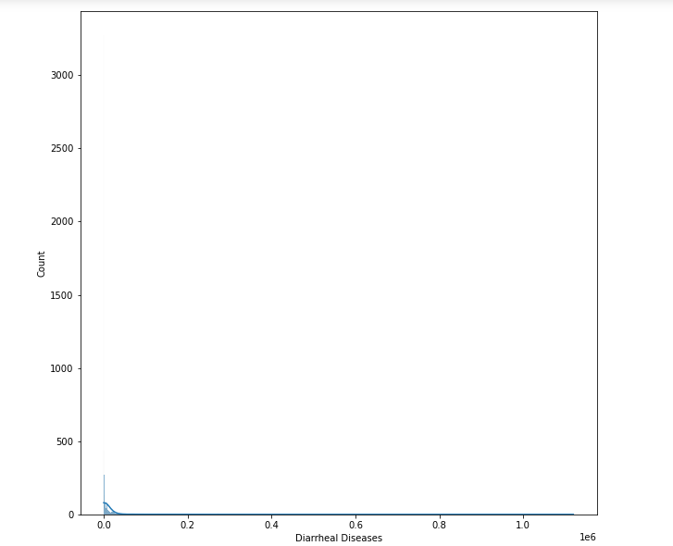
observation:
we can observe 2874 unique values in the 'Diarrheal Diseases' column and
the min value in this column is zero and the max value in the column is 1119477.
and we can observe maxumum death observed are taking place in zero in the column.
we can observe max count observations in the dataset are below 0.2 unit

Slide 28
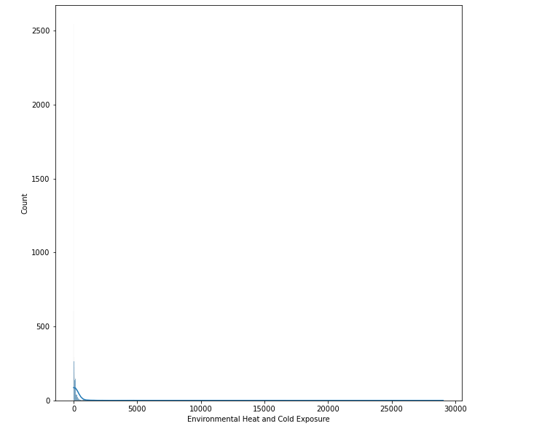
observation:
we can observe 714 unique values in the 'Environmental Heat and Cold Exposure' column and
the min value in this column is zero and the max value in the column is 29048.
and we can observe maxumum death observed are taking place in zero in the column.
we can observe max count observations in the dataset are below 5000

Slide 29
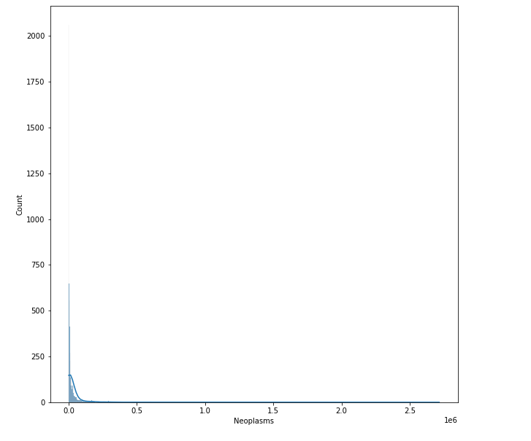
observation:
we can observe 4814 unique values in the 'Neoplasms' column and
the min value in this column is zero and the max value in the column is 2716551.
and we can observe maxumum death observed are taking place in zero in the column.
we can observe max count observations in the dataset are below 0.5 unit

Slide 30
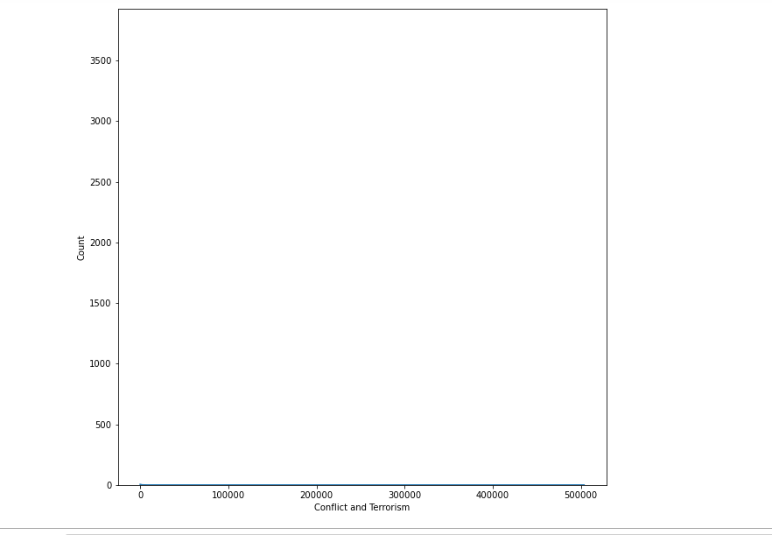
observation:
we can observe 918 unique values in the 'Conflict and Terrorism' column and
the min value in this column is zero and the max value in the column is 503532.
and we can observe maxumum death observed are taking place in zero in the column.

Slide 31
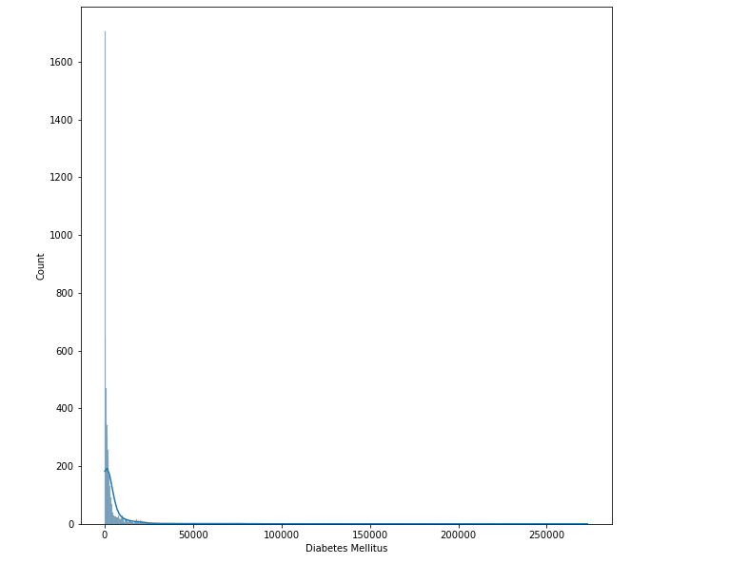
observation:
we can observe 3366 unique values in the Diabetes Mellitus column and
the min value in this column is zero and the max value in the column is 273089.
and we can observe maxumum death observed are taking place in zero in the column.
we can observe max count observations in the dataset are below 50000

Slide 32
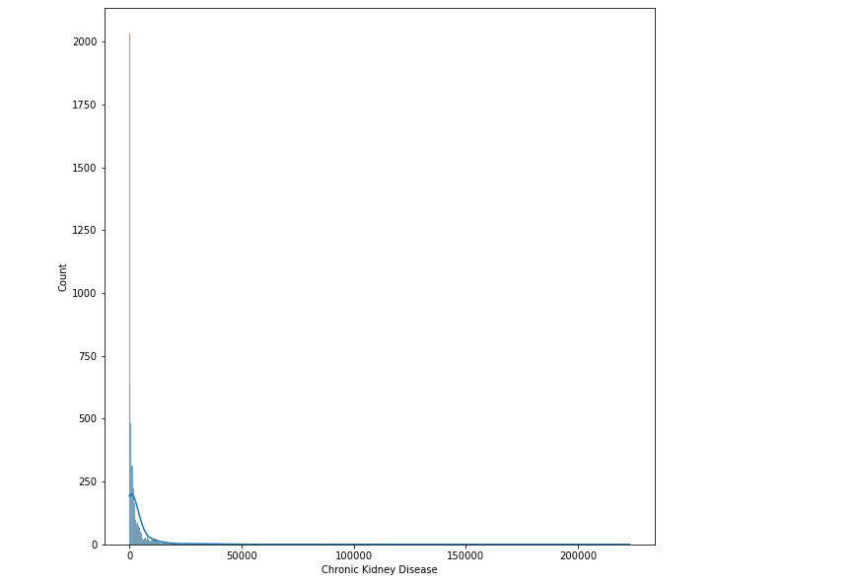
observation:
we can observe 3246 unique values in the 'Chronic Kidney Disease' column and
the min value in this column is zero and the max value in the column is 222922.
and we can observe maxumum death observed are taking place in zero in the column.
we can observe max count observations in the dataset are below 50000

Slide 33
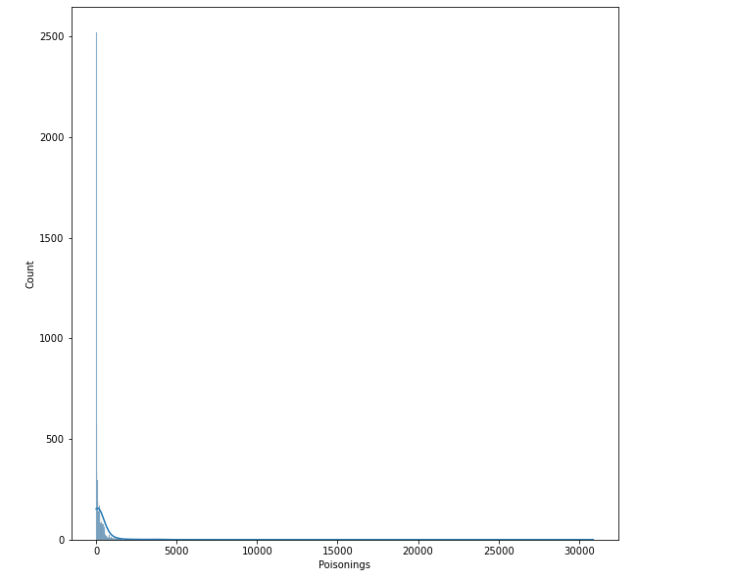
observation:
we can observe 1087 unique values in the 'Poisonings' column and
the min value in this column is zero and the max value in the column is 30883.
and we can observe maxumum death observed are taking place in zero in the column.
we can observe max count observations in the dataset are below 5000

Slide 34
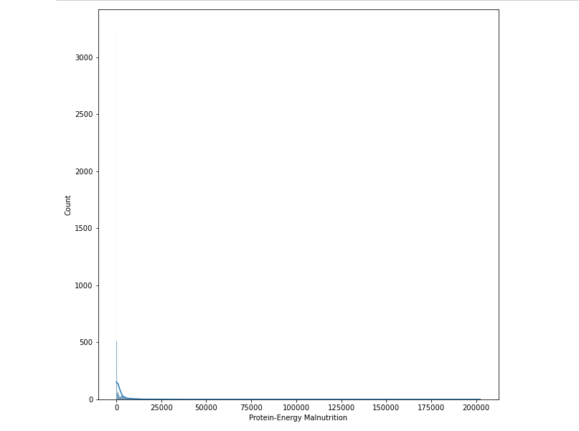
observation:
we can observe 2091 unique values in the 'Protein-Energy Malnutrition' column and
the min value in this column is zero and the max value in the column is 202241.
and we can observe maxumum death observed are taking place in zero in the column.
we can observe max count observations in the dataset are below 25000

Slide 35
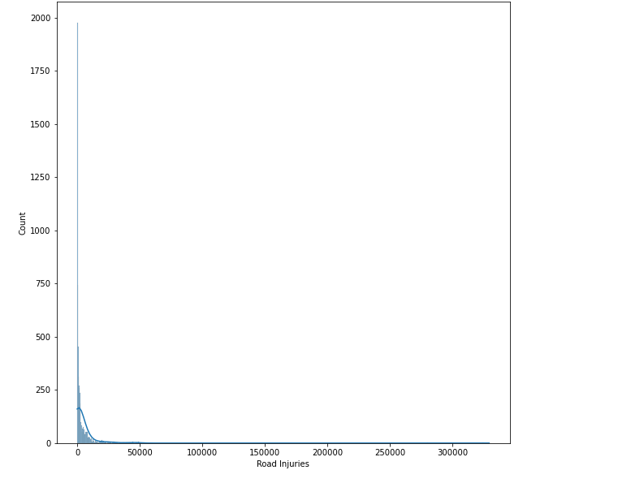
observation:
we can observe 3393 unique values in the 'Road Injuries' column and
the min value in this column is zero and the max value in the column is 329237.
and we can observe maxumum death observed are taking place in zero in the column.
we can observe max count observations in the dataset are below 50000

Slide 36
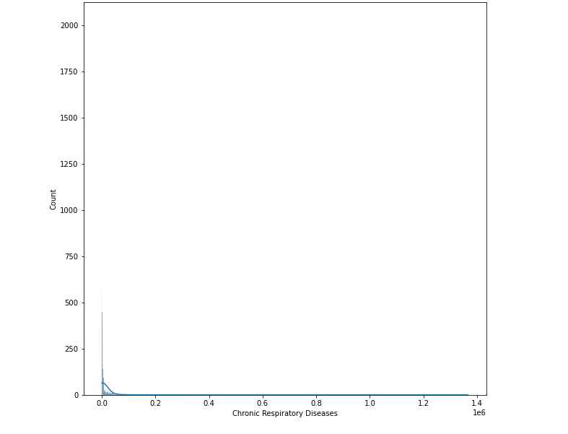
observation:
we can observe 3393 unique values in the 'Chronic Respiratory Diseases' column and
the min value in this column is zero and the max value in the column is 1366039.
and we can observe maxumum death observed are taking place in zero in the column.
we can observe max count observations in the dataset are below 0.2 units

Slide 37
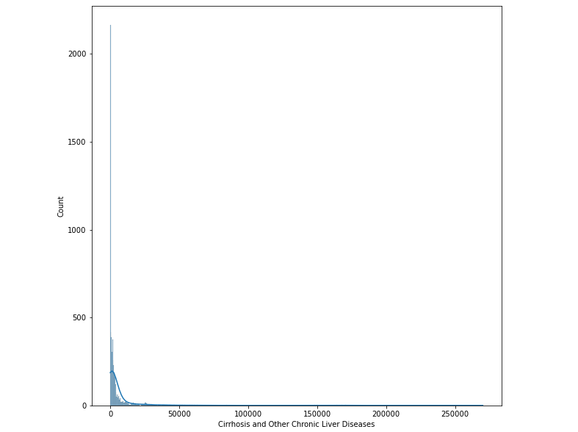
observation:
we can observe 3443 unique values in the 'Cirrhosis and Other Chronic Liver Diseases' column and
the min value in this column is zero and the max value in the column is 270037.
and we can observe maxumum death observed are taking place in zero in the column.
we can observe max count observations in the dataset are below 50000

Slide 38
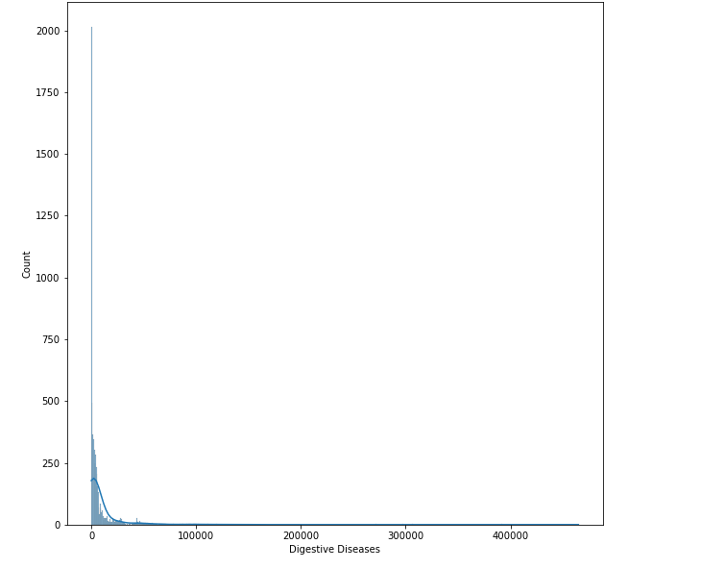
observation:
we can observe 4023 unique values in the 'Digestive Diseases' column and
the min value in this column is zero and the max value in the column is 464914.
and we can observe maxumum death observed are taking place in zero in the column.
we can observe max count observations in the dataset are below 1000000

Slide 39
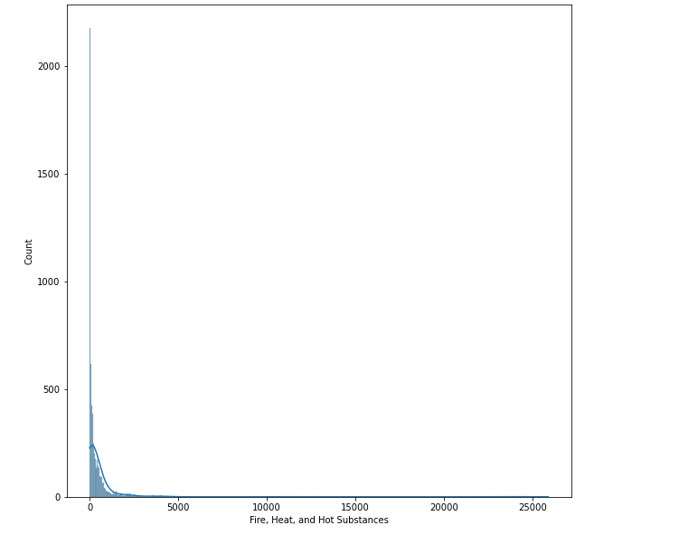
observation:
we can observe 1406 unique values in the 'Fire, Heat, and Hot Substances' column and
the min value in this column is zero and the max value in the column is 25876.
and we can observe maxumum death observed are taking place in zero in the column.
we can observe max count observations in the dataset are below 5000

Slide 40
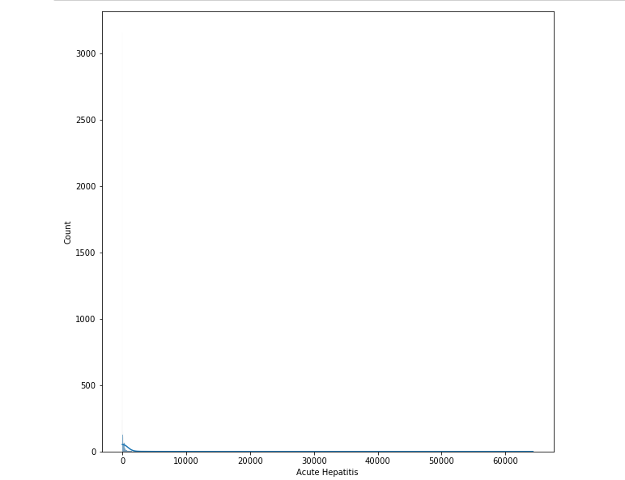
observation:
we can observe 1059 unique values in the 'Acute Hepatitis' column and
the min value in this column is zero and the max value in the column is 64305
and we can observe maxumum death observed are taking place in zero in the column.
we can observe max count observations in the dataset are below 10000

Slide 41
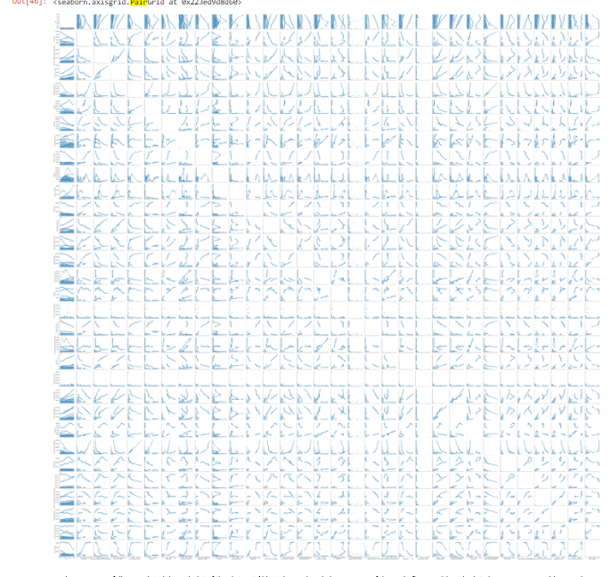
Pair plot

Slide 42
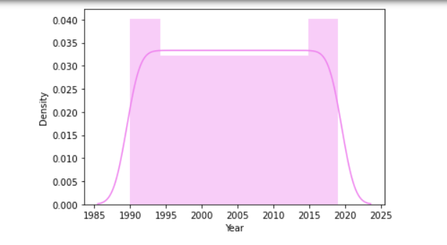
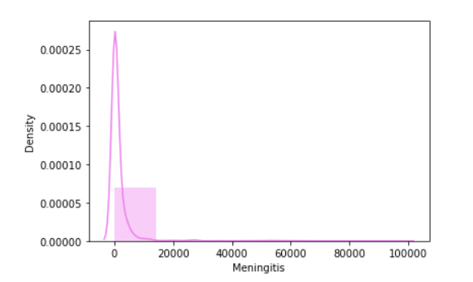
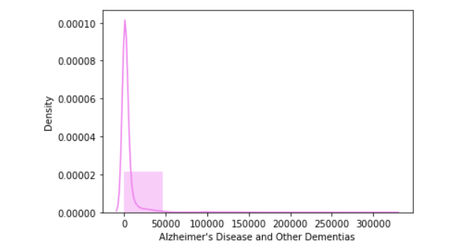
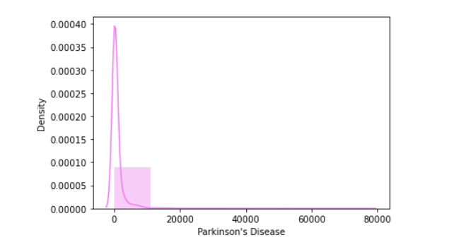
Skewness check

Slide 43
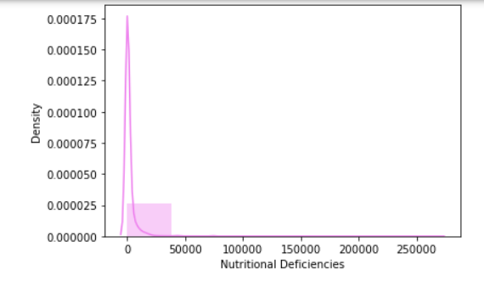
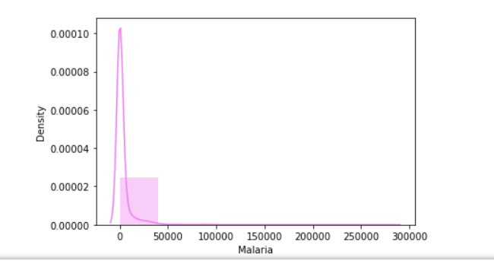
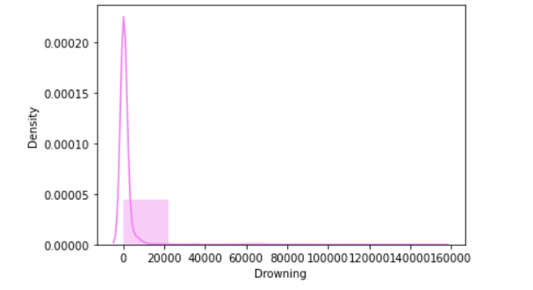
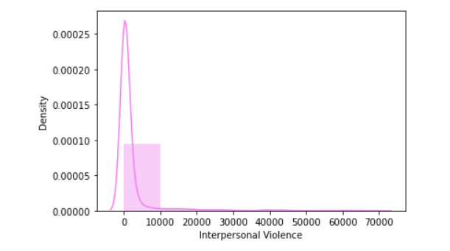
Skewness check

Slide 44
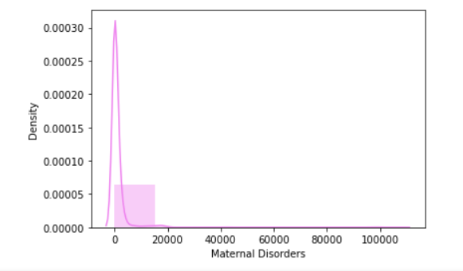
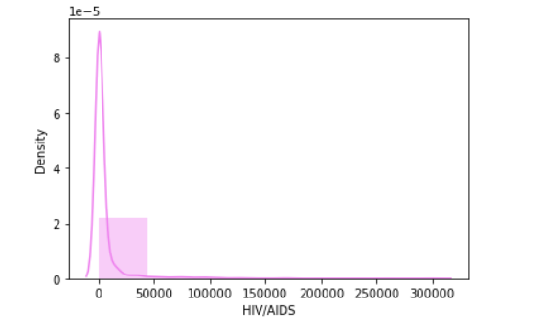
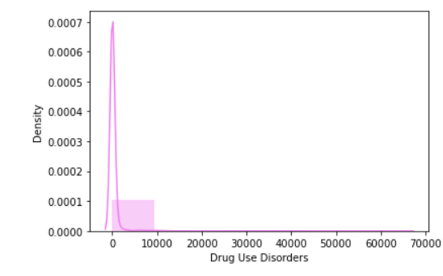
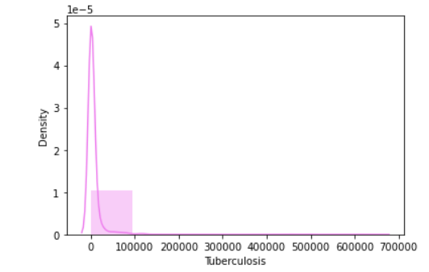
Skewness check

Slide 45




Skewness check

Slide 46




Skewness check

Slide 47




Skewness check

Slide 48




Skewness check

Slide 49




Skewness check

Slide 50


Outliers visulaization

Slide 51


Outliers visulaization

Slide 52


Outliers visulaization

Slide 53

Heatmap

Slide 54
Done With EDA

